Slide 1
EECS-731 Understanding climate change with data-science
Team Oracle
Austin Adams
Pushkar Singh Negi
Ravali Kondreddi
Ronald Moore
Waqar Ali

Slide 2
Introduction
What is this project about?
What is climate-change?
Make hypothesis about factors which cause climate-change
Consumption of fossil-fuels
Emission of CO₂
Population increase
Melting of polar ice-caps
Emission of Ozone depleting substances

Slide 3
Introduction
Role of Data-Science
Identify if we can correlate the trends in the identified factors over the years with climate-change trend
Use classification / clustering techniques to make predictions
Explore the occurrence of natural disasters in the last century
Correlate with climate change trend
Use time-series forecasting to predict future disaster trend

Slide 4
Work-Flow
CO2
Fossil Fuels
Ozone Layer
Population
Sea-Level
Data Collection
Merged Dataframe
Clustering
Classification
Anomaly Detection
Statistical Analysis
Forecasting
Merged Dataframe
Faceting
Conclusions

Slide 5
Data Exploration

Slide 6
Global Temperature
Features
Timestamp
Average Land Temperature (Celsius)
Uncertainty in Average Land Temperature
Max Land Temperature
Uncertainty in Max Land Temperature
Average Land and Sea Temperature (Celsius)
Uncertainty in Average Land and Sea Temperature

Slide 7
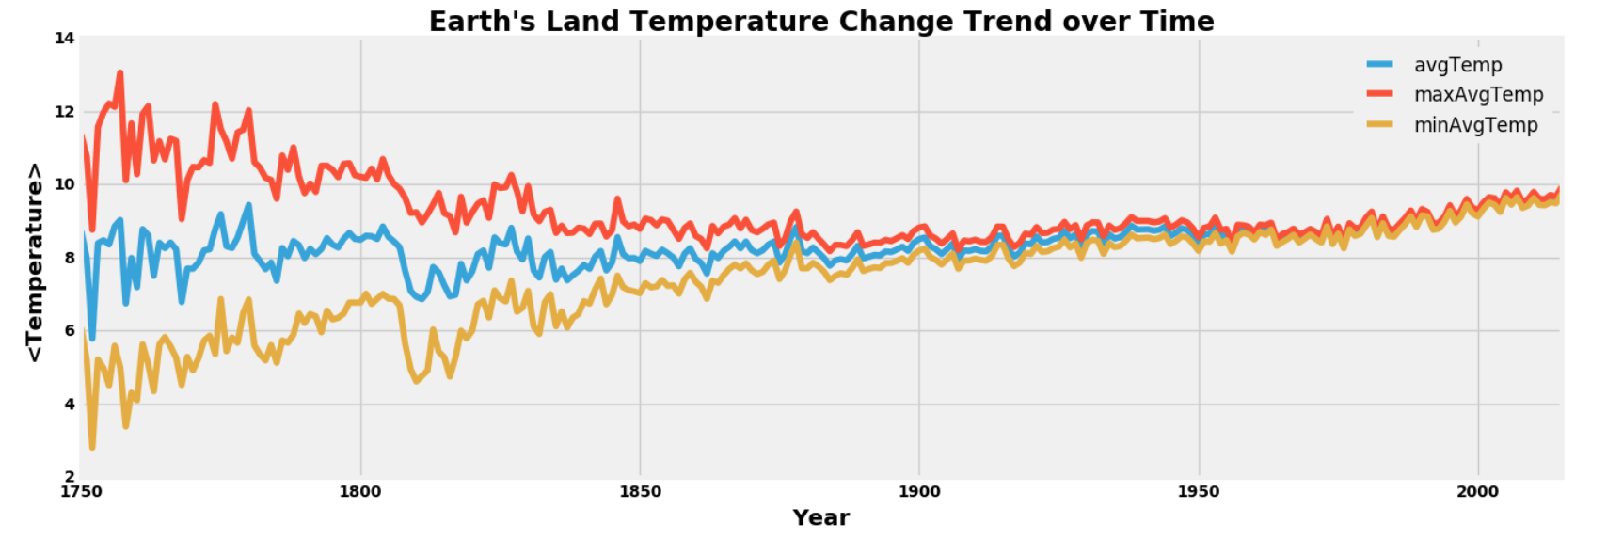
Global Temperature
Annual Trend

Slide 8
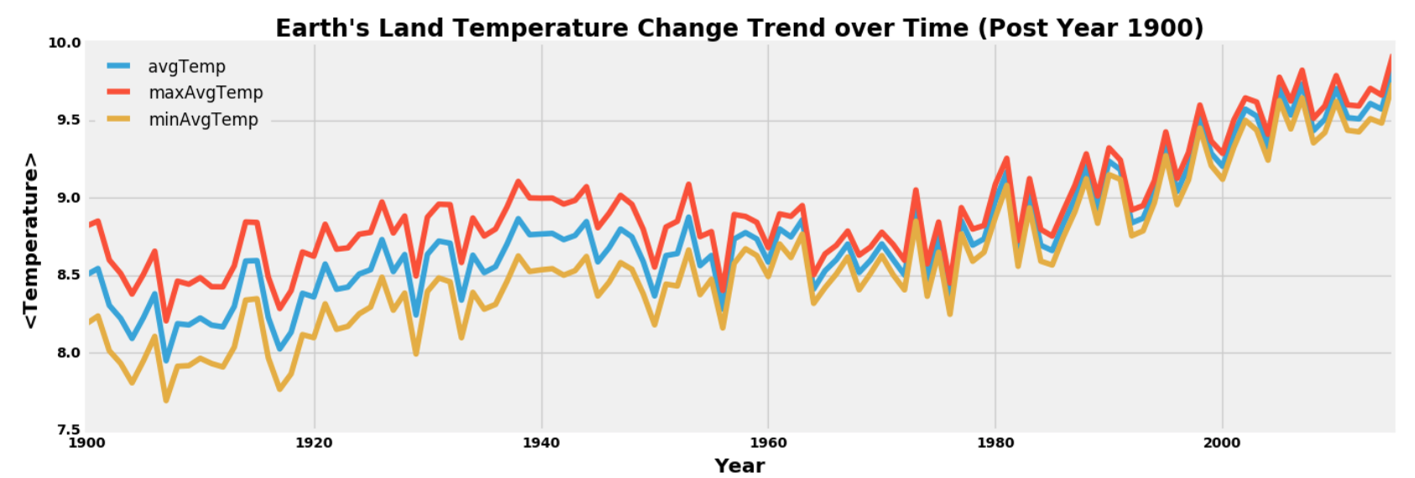
Global Temperature
Annual Trend (Last Century)

Slide 9
CO₂ Emission
Features
Year
Entity (Country Name)
Code (Country Code)
Annual CO₂ Emission (Million Tonnes)
Strategy
Aggregate values on a per-year basis across all entities

Slide 10
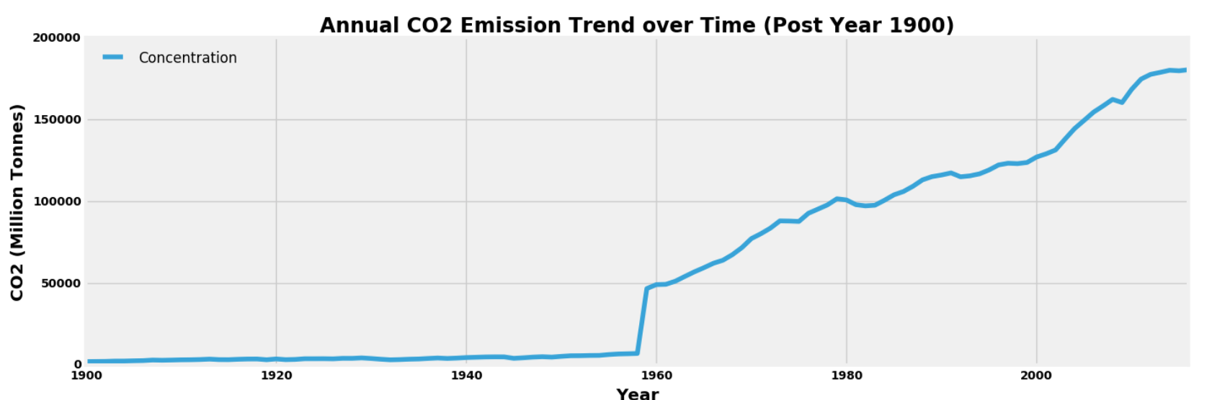
CO₂ Emission
Annual Trend (Last Century)

Slide 11
Sea-Level rise
Features
Year
GMSL (Global Mean Sea Level)
GMSL Uncertainty
Units : Millimeter

Slide 12
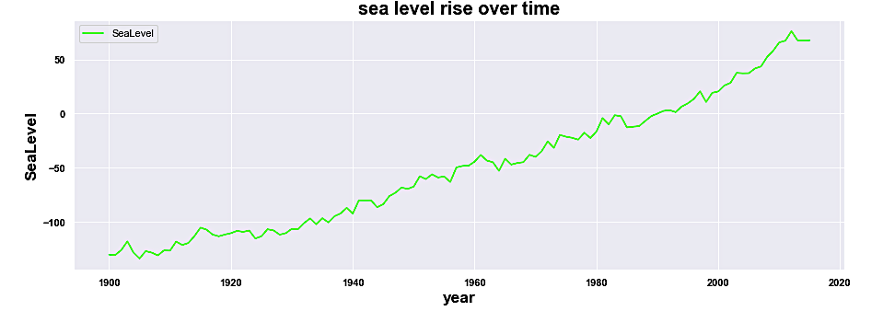
Sea-Level rise
Annual Trend(Last Century)

Slide 13
Fossil Fuels
Oil, Coal, Gas
Year
Annual Consumption (Terawatt Hours)

Slide 14
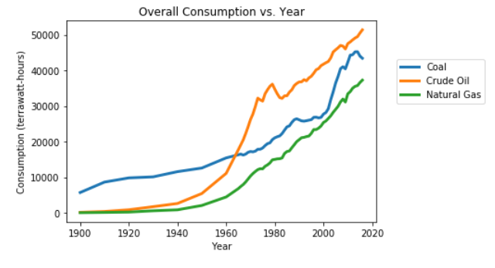
Fossil fuels
Annual Trend(Last Century)

Slide 15
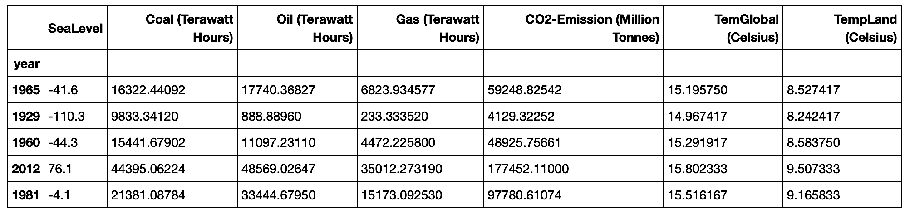
Merged dataset
Features
Notes:
Replace this snapshot

Slide 16
Clustering

Slide 17
Merged Dataset: Clustering
Analysis
Clustering : Temperature column values
Clustering : The features
Accuracy
Feature selection

Slide 18
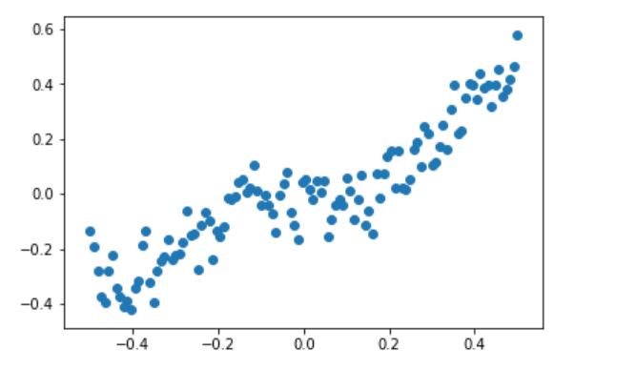
Clustering: Temperature values
Normalizing the values

Slide 19
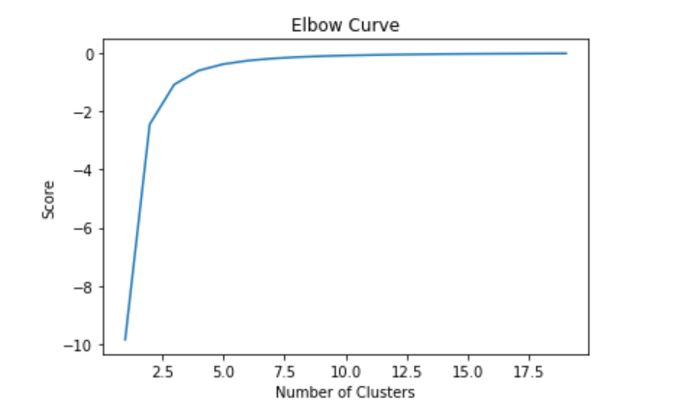
Clustering: Temperature values
Elbow curve: To determine the number of clusters

Slide 20
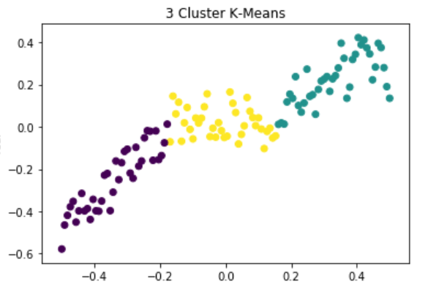
Clustering: Temperature values
K-Means Clustering (n=3)

Slide 21
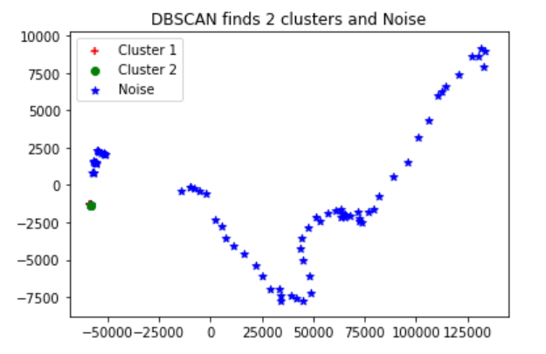
Clustering: Features
Density-Based Spatial Clustering of Applications with Noise

Slide 22
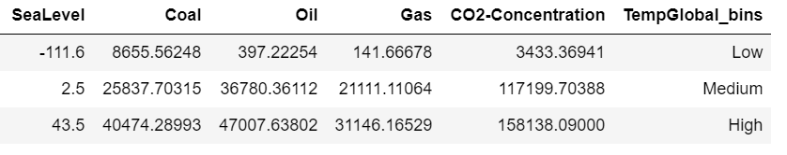
Clustering
Data binning: Temperature
Group a number of more or less continuous values into a smaller number of "bins“.
Created 3 bins
14.775, 15.204 = Low
15.204, 15.631 = Medium
15.631, 16.059 = High

Slide 23
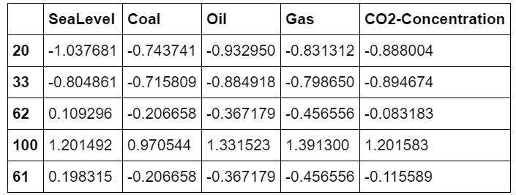
Clustering
Processing Features
Data is unbalanced (e.g., Oil is 3x Gas): Feature Scaling

Slide 24
clustering
K-Means
Clustering on the 5d data and see if we can reproduce the actual clusters
Assumption: We don't have the TempGlobal bins labels (final labels)
Aim: Divide the data into TempGlobal bins (i.e. low, medium and high)

Slide 25
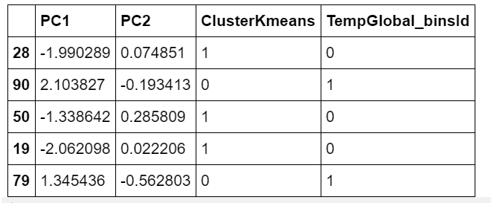
clustering
Principal Component Analysis
Goal: to reduce the dimensionality of the original feature space by projecting it onto a smaller subspace.
5 dimensional to 2 dimensional i.e. PCA1 and PCA2
Result:

Slide 26
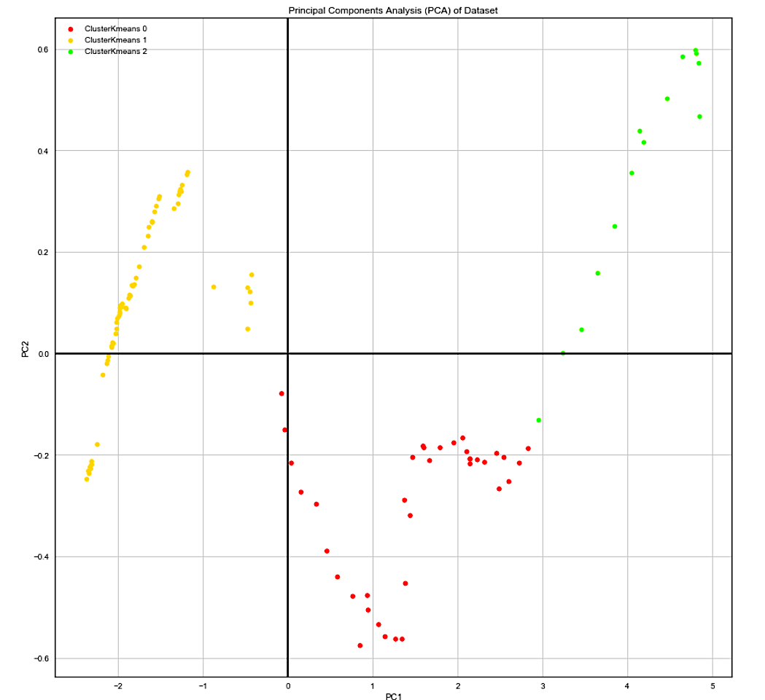
clustering
K means clustering: Predicted

Slide 27
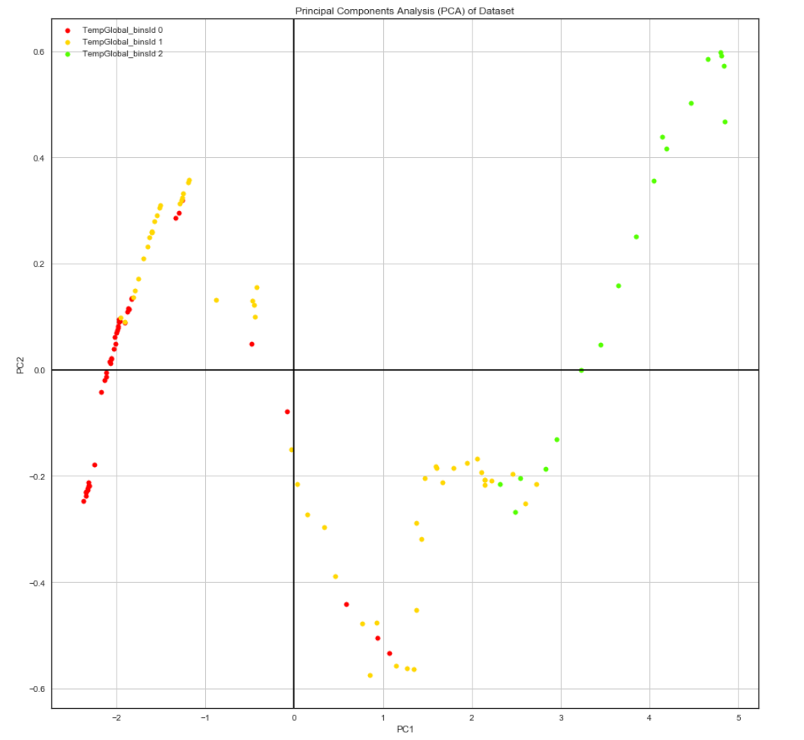
clustering
K means clustering: Actual
Accuracy: 30.73%

Slide 28
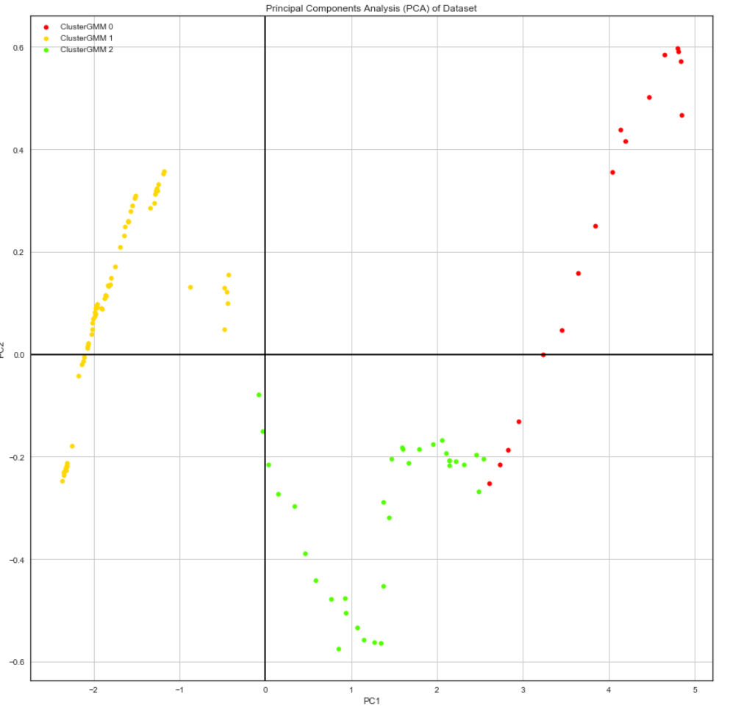
Clustering
Gaussian Mixture Model (GMM) Clustering
Accuracy: 29.60%

Slide 29
clustering
Feature Selection: Ranking of features
Algorithm | Rank1 | Rank2 | Rank3 | Rank4 | Rank5
CorrelationAttributeEval | SeaLevel | Oil | Coal | CO2-Concentration | Gas
GainRatioAttributeEval | SeaLevel | CO2-Concentration | Gas | Oil | Coal
OneRAttributeEval | SeaLevel | Gas | Oil | Coal | CO2-Concentration
InfoGainAttributeEval | Coal | SeaLevel | Oil | Gas | CO2-Concentration
PrincipalComponents | SeaLevel | Coal | Oil | Gas | CO2-Concentration

Slide 30
Classification

Slide 31
Classification
Aim
Try different features to accurately predict the class of the temperature
Observe which features are contributing the most to the increase in temperature

Slide 32
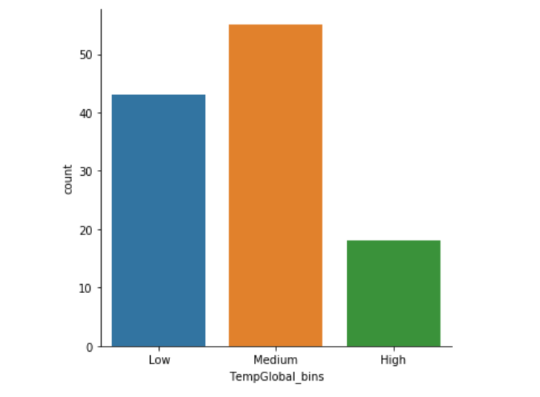
Pre-processing
Discretization
Range of temperature values very small
Temperature values placed into 3 separate bins (low, medium, high)

Slide 33
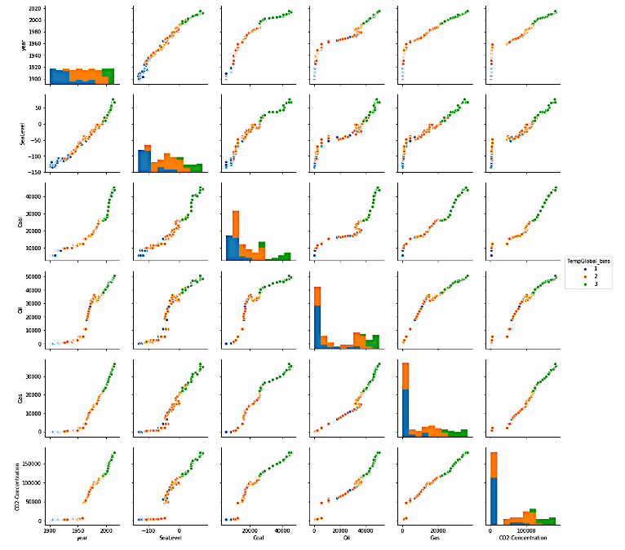
Feature Analysis
Pair-Plot
Sea-Level
Coal
Oil
Gas
CO₂
Sea-Level
Coal
Oil
Gas
CO₂

Slide 34
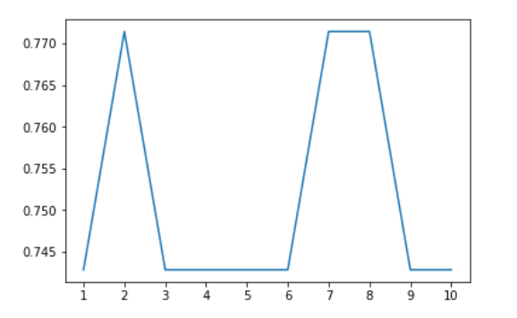
Classification
K-Nearest Neighbors (KNN)
Accuracy
N

Slide 35
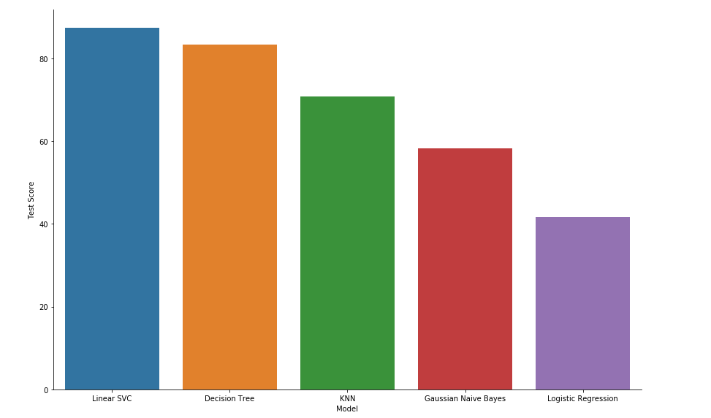
Classification
80
60
Accuracy (%)
40
20
Linear SVC
Decision Tree
KNN
Naïve-Bayes
Logistic Regression

Slide 36
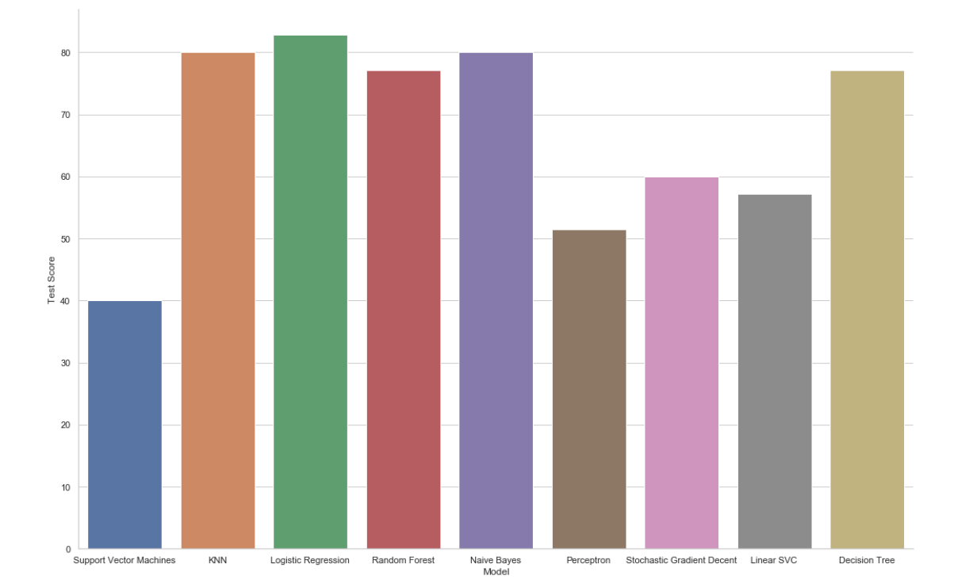
PROCESS (Continued)
Classification Using All Features

Slide 37
Anomaly Detection

Slide 38
Anomaly detection
Detecting outliers in the data
Used to identify unusual patterns in data
Plot anomalies between year and each feature
Isolation forest
Isolation forest measure the outlierness of a point by determining how long it takes to isolate that point
Question: Can the anomalies in Global Temperature Trend be correlated with the anomalies in the feature?

Slide 39
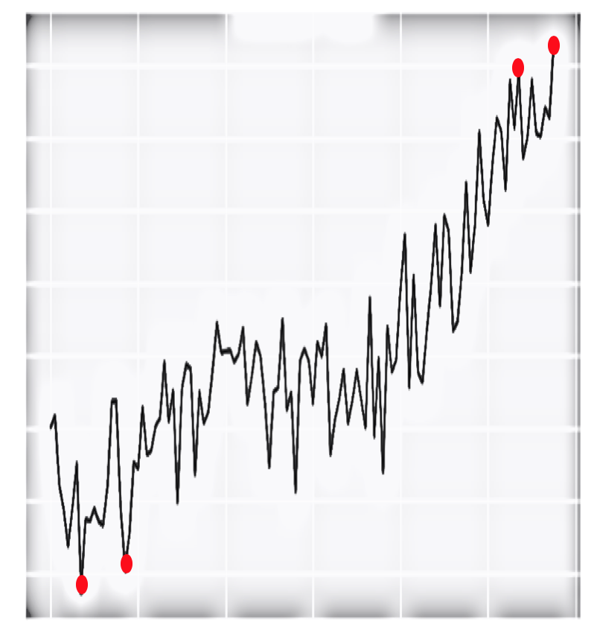
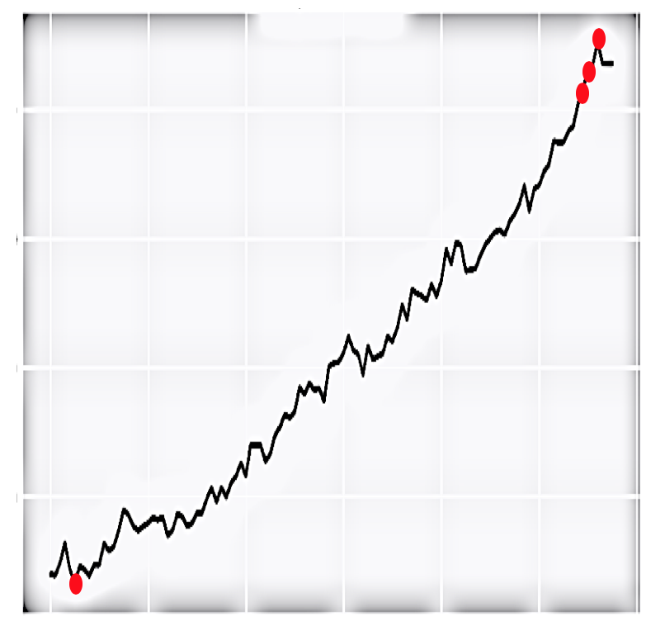
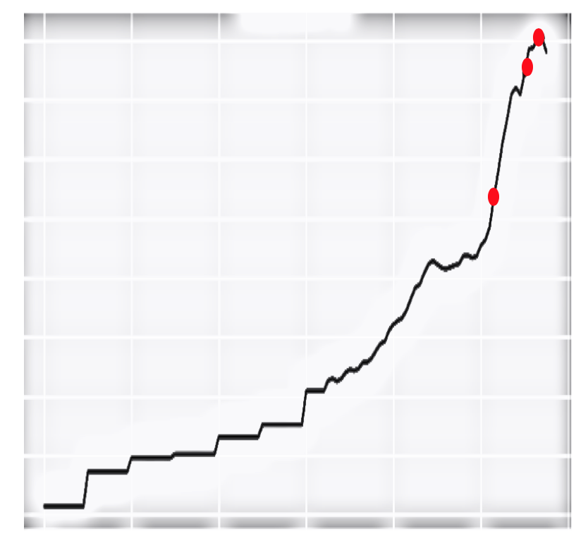
Anomaly plots
Anomalies:
Temperature (Celsius)
Sea-Level (GMSL)
Coal Consumption (Terawatt Hours)
Year
Year
Year

Slide 40
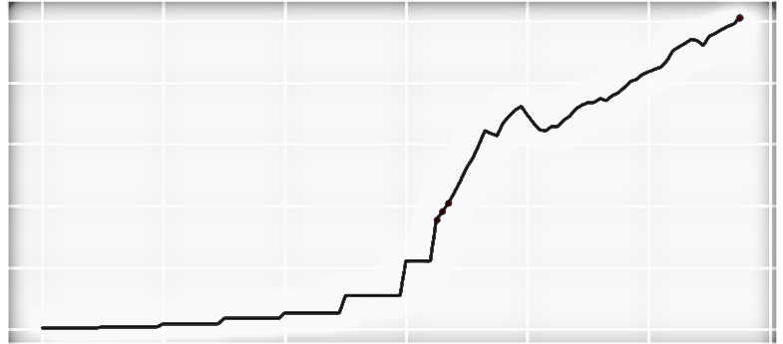
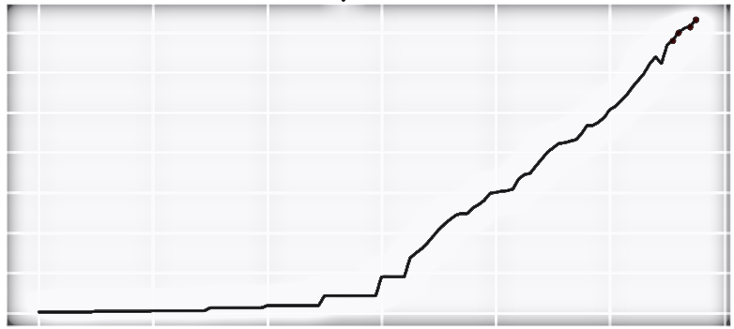
Anomaly plots
Anomalies:
Oil Consumption(Terawatt Hours)
Natural Gas Consumption (Terawatt Hours)
Year
Year

Slide 41
Anomaly detection
Conclusion
A few anomalies in global temperature occur in the same years as the anomalies in the sea-level dataset
Drastic temperature change in a particular year directly affects the global sea-level
Cannot make definitive conclusions about other datasets
In 2015 oil, gas and global temperature have anomalies
Those two might be the possible factors that have contributed more in that year to temperature change.

Slide 42
Natural Disasters

Slide 43
Natural Disasters
Question
Is climate-change causing (some) natural disasters?
What disaster type is highly correlated with global temperature change trend?
Can we forecast future occurrence of natural disasters based on climate-change?

Slide 44
Natural disasters
Features
Year
Entity
Disaster type
Reports
Number of disaster events reported for the specified entity in a given year

Slide 45
Natural disasters
Exploration
Create separate data-frames for each disaster type
Merge each DF with temperature land data-frame (Outer-join based on year)
Decompose each entity into its trend and noise (EWMA)
Understand how each entity (and its trend) correlates with global temperature value (and its trend)

Slide 46
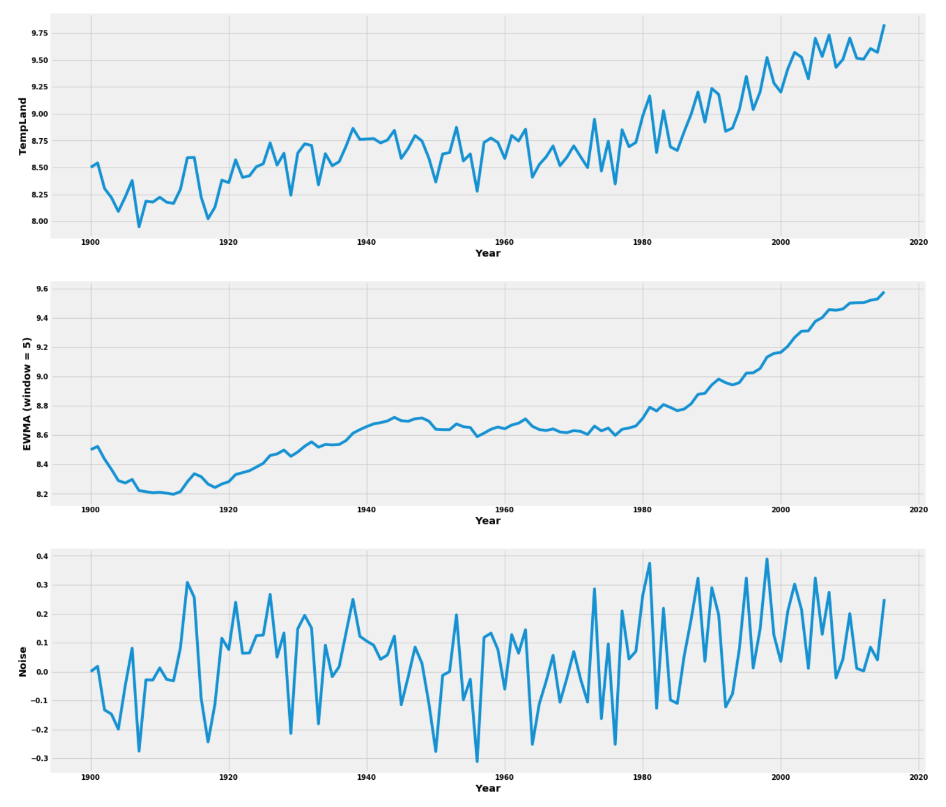

Slide 47
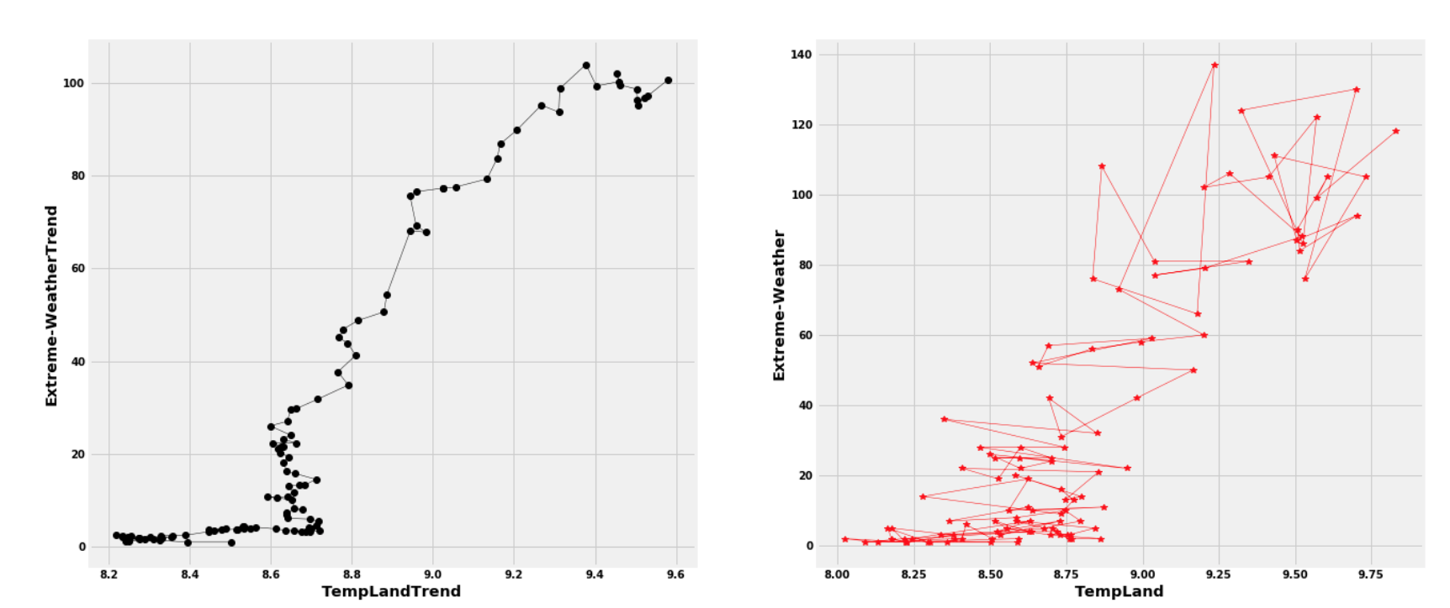
Natural disasters
Raw Data vs Trends

Slide 48
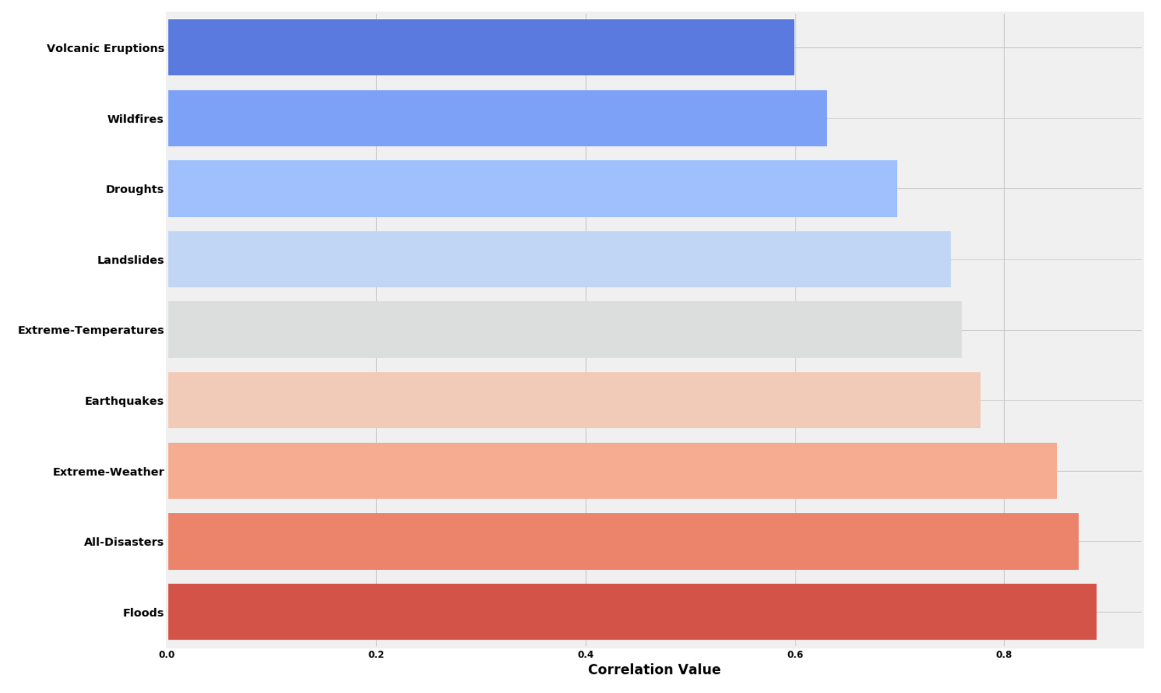
Natural disasters
Correlation with Global Temperature Change

Slide 49
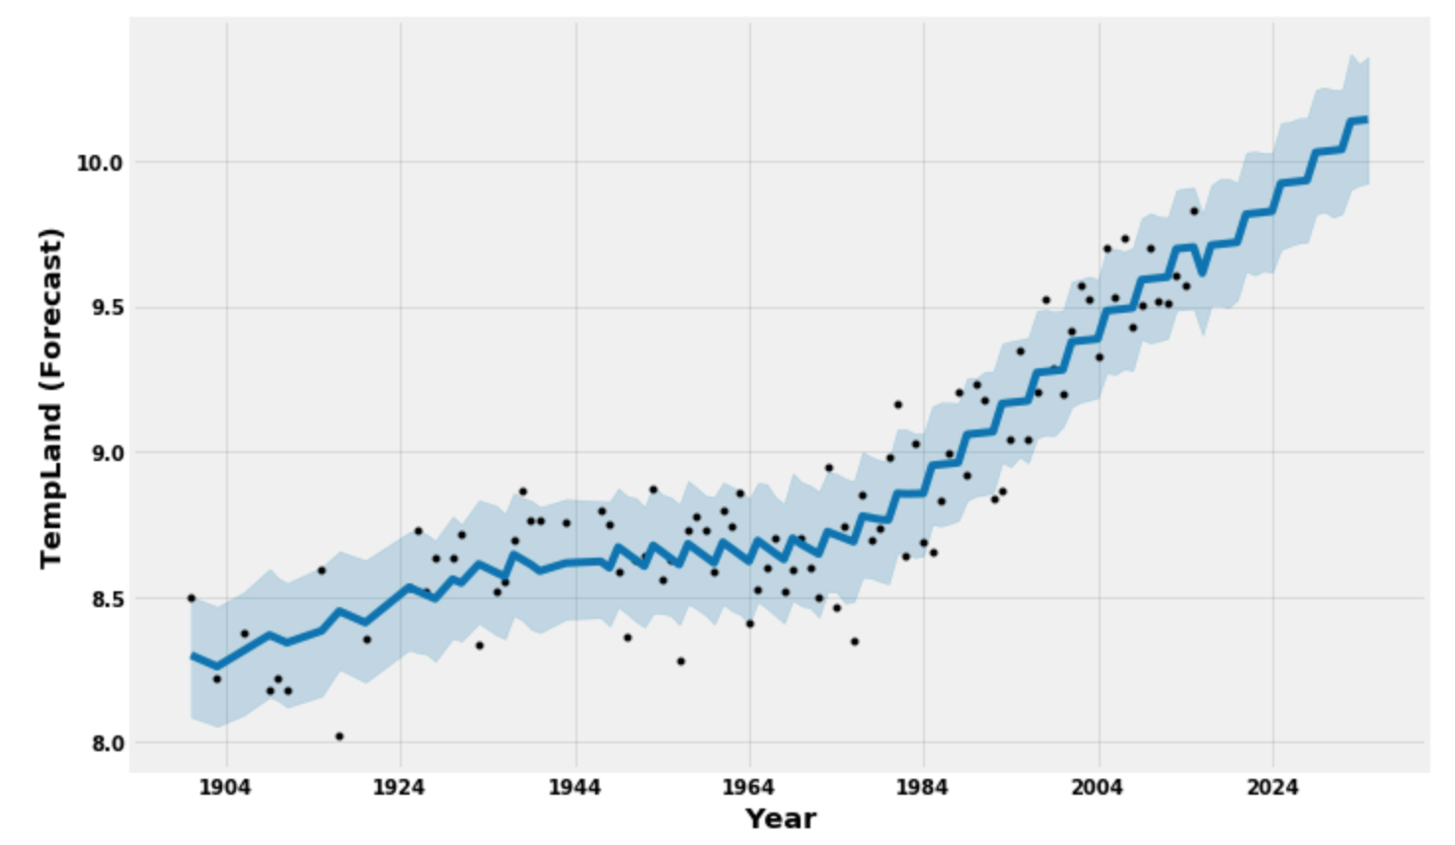
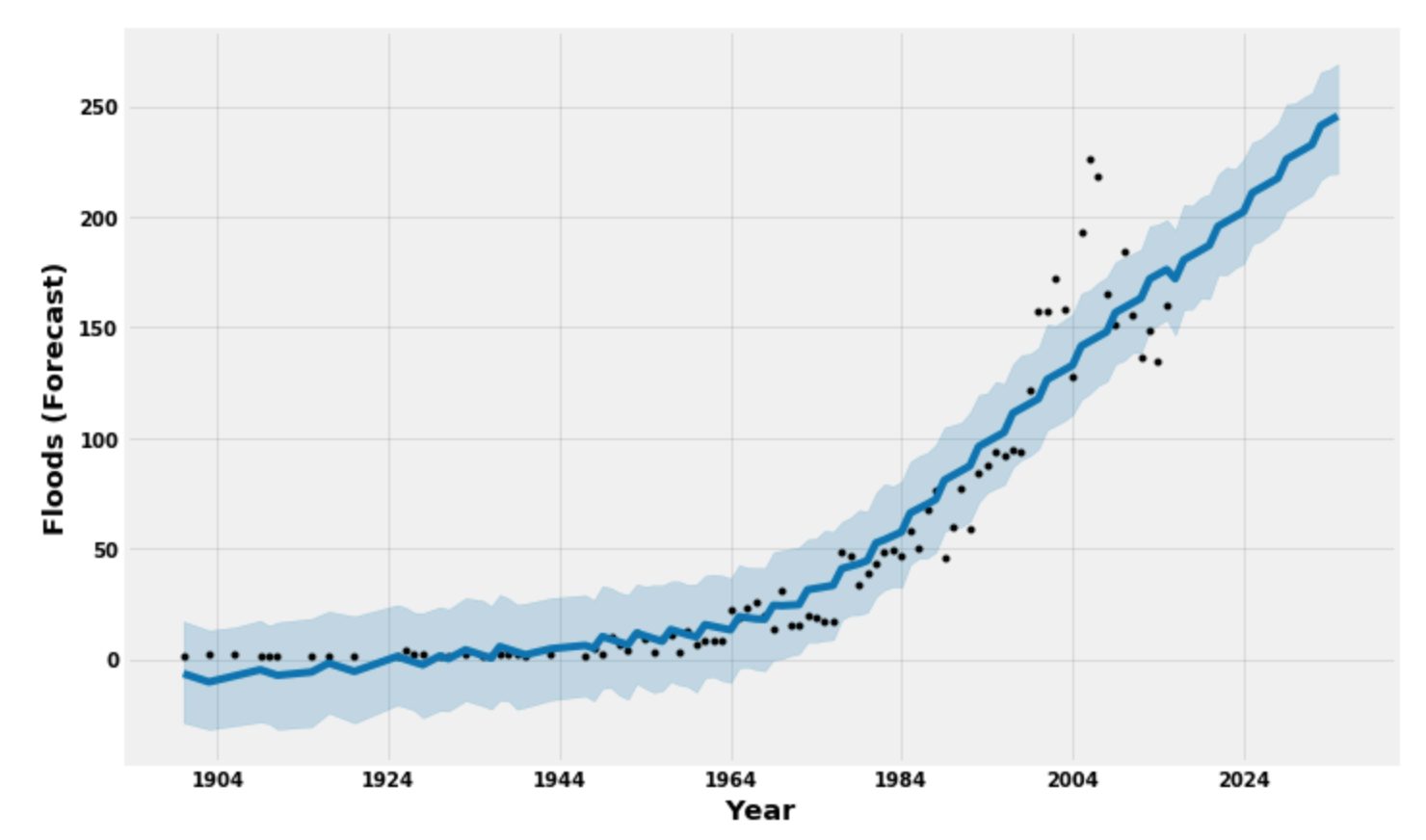
Natural disasters
Forecasting with FbProphet

Slide 50
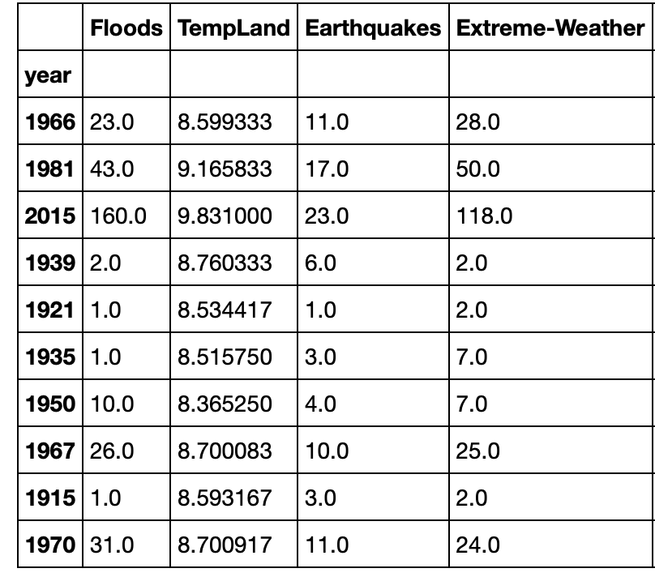
Natural disasters
Classification
Create a new data-frame
Features: Global Land Temperature, Earthquakes, Extreme-Weather, Floods
Goal: Can we classify floods taking other attributes as features?

Slide 51
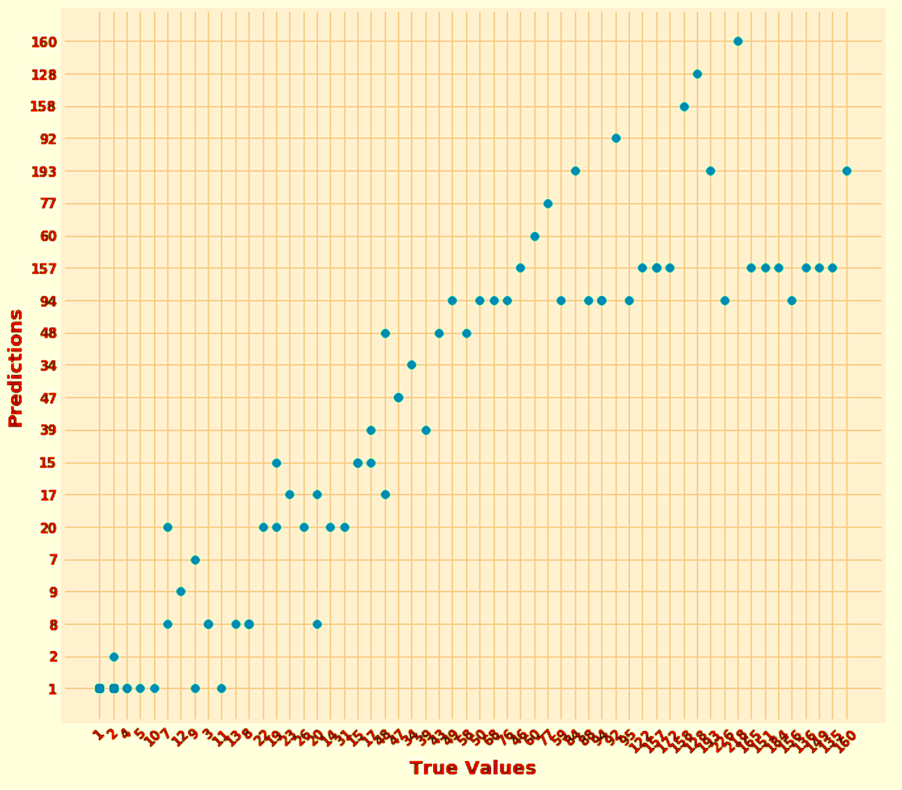
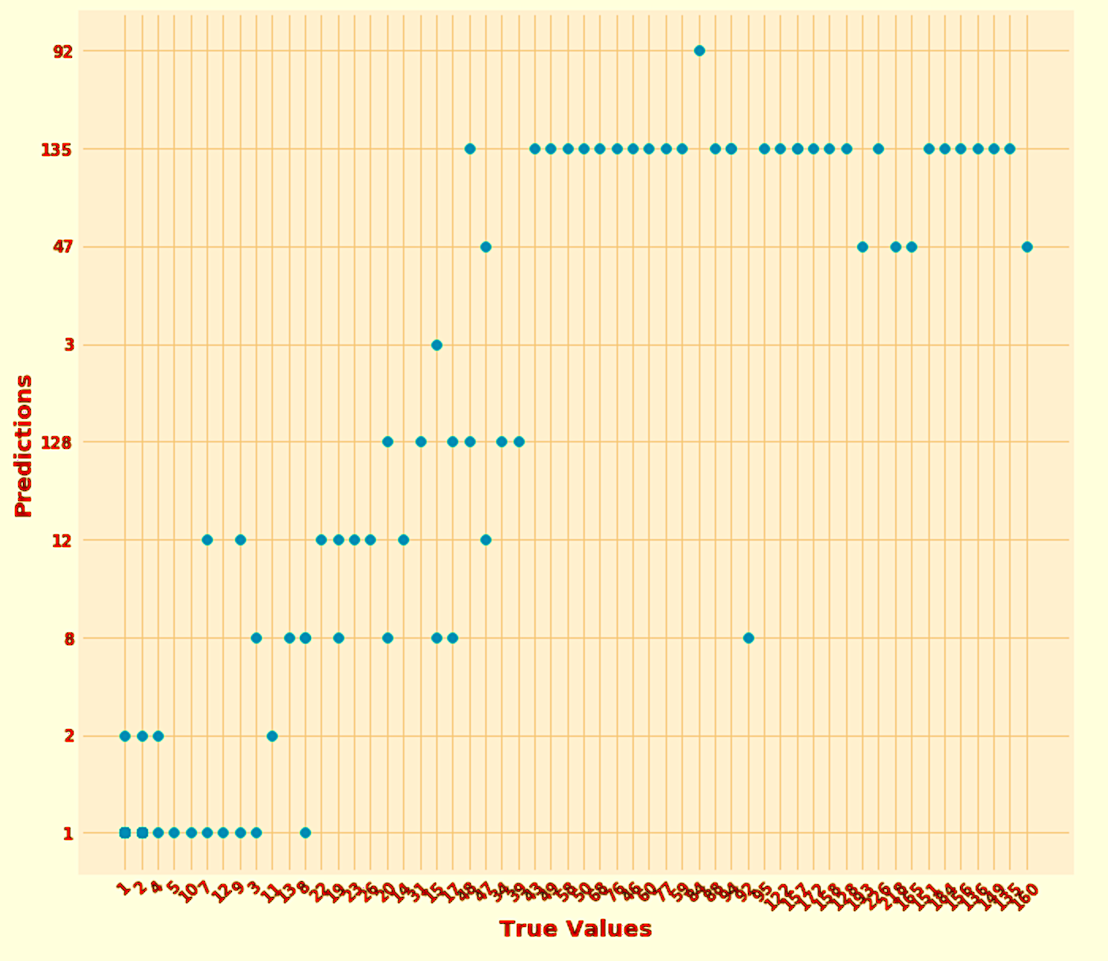
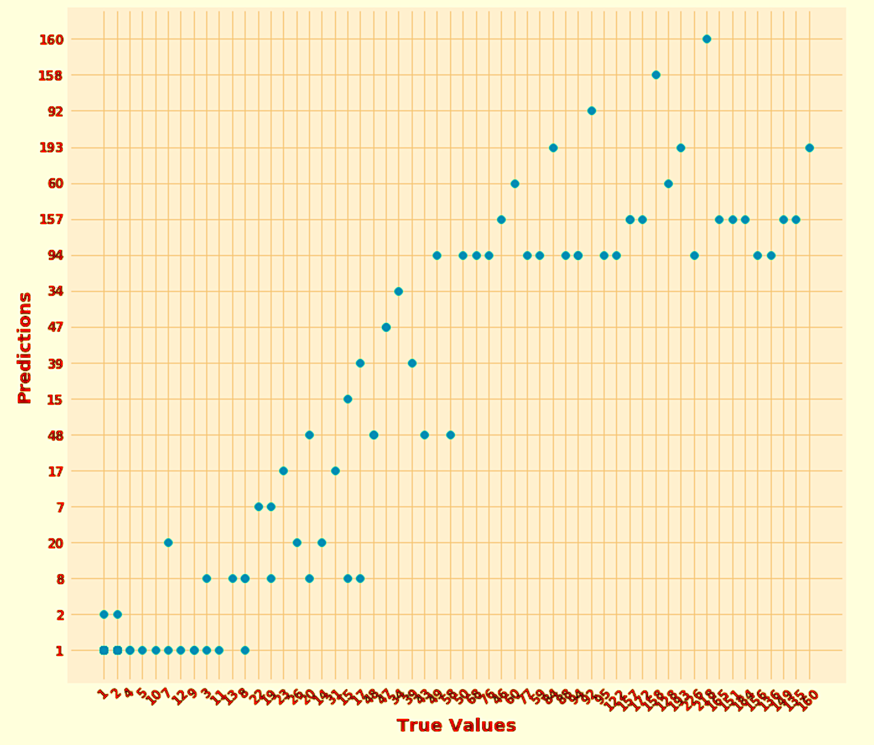
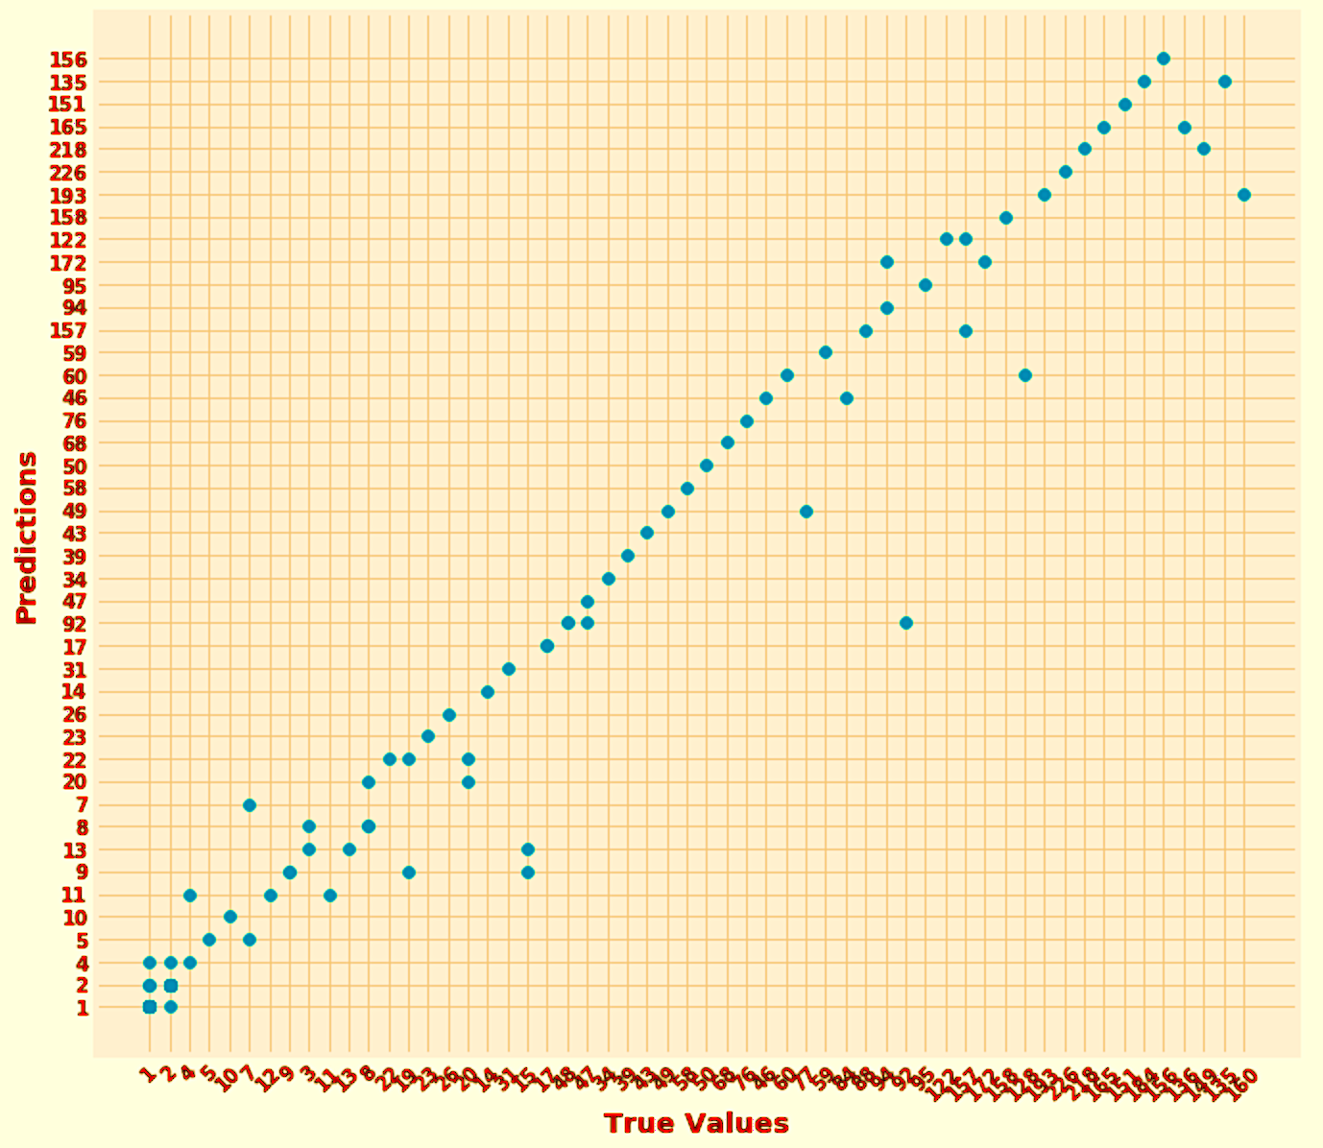
Natural disasters
Classification
Multinomial Naïve-Bayes
Accuracy: 45%
Linear SVC
Accuracy: 30%
Logistic Regression
Accuracy: 41%
Random Forest
Accuracy: 74%

Slide 52
Statistical Analysis

Slide 53
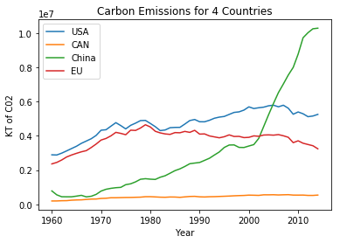
Global Emissions
By Country Basis

Slide 54
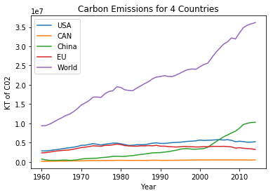
Global Emissions
Including the World

Slide 55
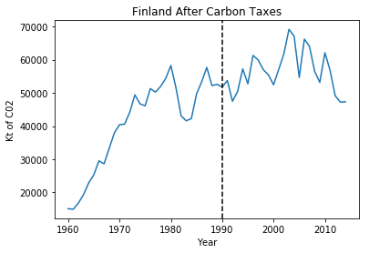
Post Carbon Taxes
Finland

Slide 56
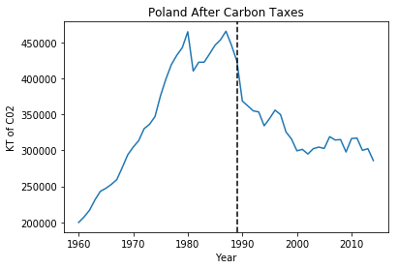
Post carbon Taxes
Poland

Slide 57
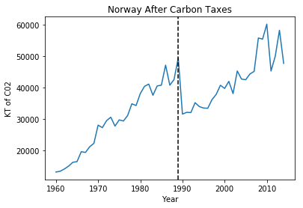
Post Carbon Taxes
Norway

Slide 58
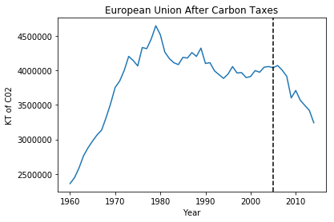
Post Carbon Taxes
European Union

Slide 59
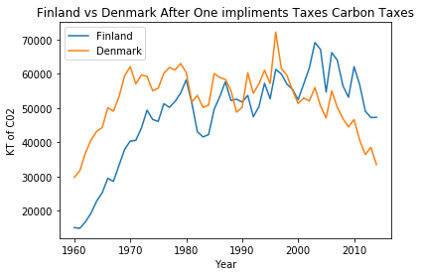
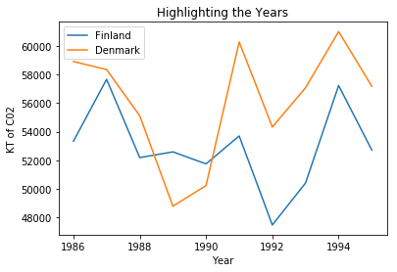
Comparable Countries
Post Carbon Taxes

Slide 60
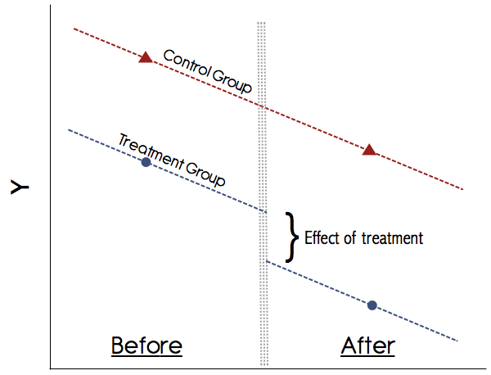
Statistical Analysis
Difference in Differences

Slide 61
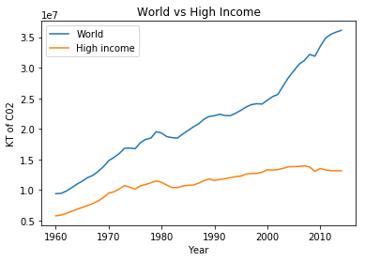
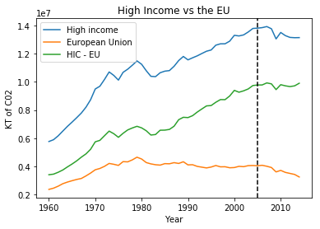
Statistical Analysis
High Income vs EU

Slide 62
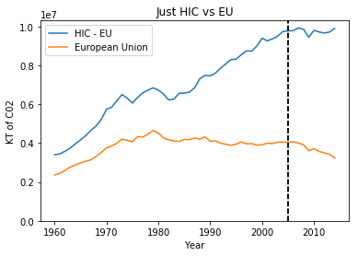
HIC vs EU
A Numbers Story
Percent Change from 2004 - 2014
-4.8% Change for High Income Countries
+1.6% Change for HIC – EU
-25.12% Change for the EU

Slide 63
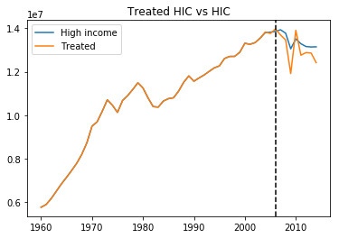
HIC vs EU
A Numbers Story

Slide 64
Learning outcomes

Slide 65
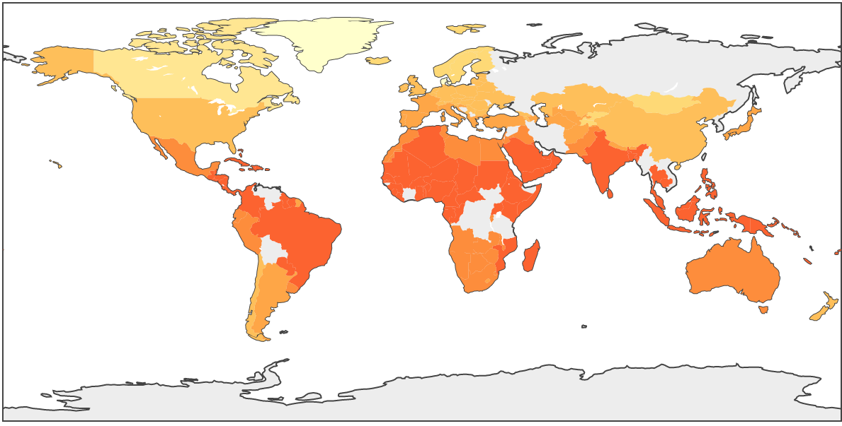
World-map
1948

Slide 66

World-map
2013

Slide 67
Learning outcomes
EECS-731
Understood the extraordinary complications involved in aggregating and working on datasets from multiple sources
Spent multiple weeks on finding / exploring and (ultimately) discarding multiple datasets related to climate-change from a number of online sources
More clarity on how to collect quality data when working with time-series
More finely tuned data -> better forecasting models
Used a number of algorithms from this course
Better understanding of the nuances involved in using these algorithms for answering practical questions

